Slide 1
區塊鏈的介紹及應用
term project 2 : Smart Contract

Slide 2
Our goal to this term project
認識 Metamesk 錢包、Sepolia測試鏈
學習Solidity 基本語法
學習撰寫、佈署、操作智能合約

Slide 3
Environment
Remix IDE (online version)
Solidity 0.8.19
Compiler 0.8.19+commit.7dd6d404

Slide 4
MetaMask (狐狸錢包) (1/3)
1. 用於與以太坊區塊鏈進行互動的軟體加密貨幣錢包。
2. 使用Google提供的擴充應用程式，直接於瀏覽器上使用程式。

Slide 5
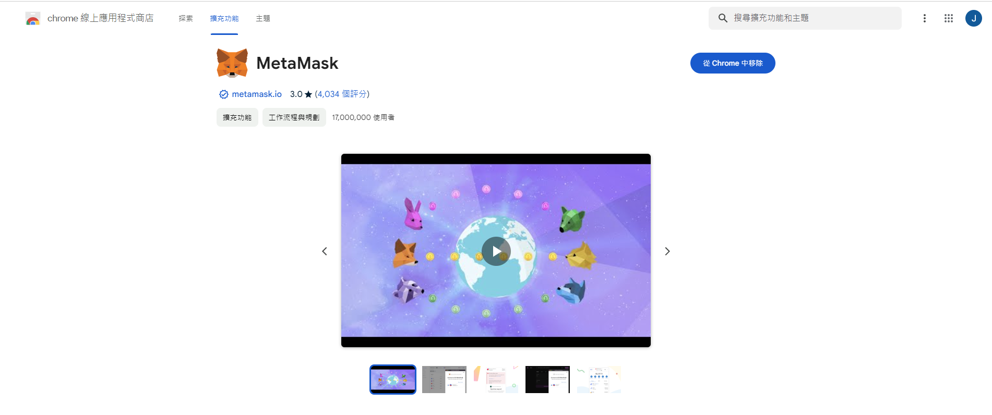
MetaMask (狐狸錢包) (2/3)

Slide 6
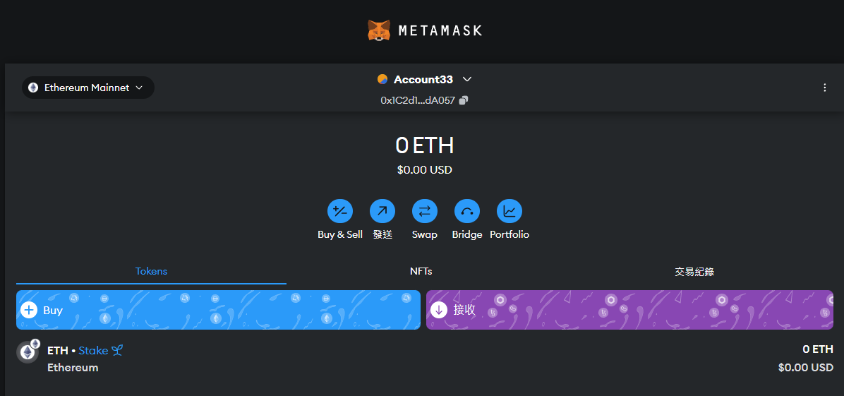
MetaMask (狐狸錢包) (2/3)

Slide 7
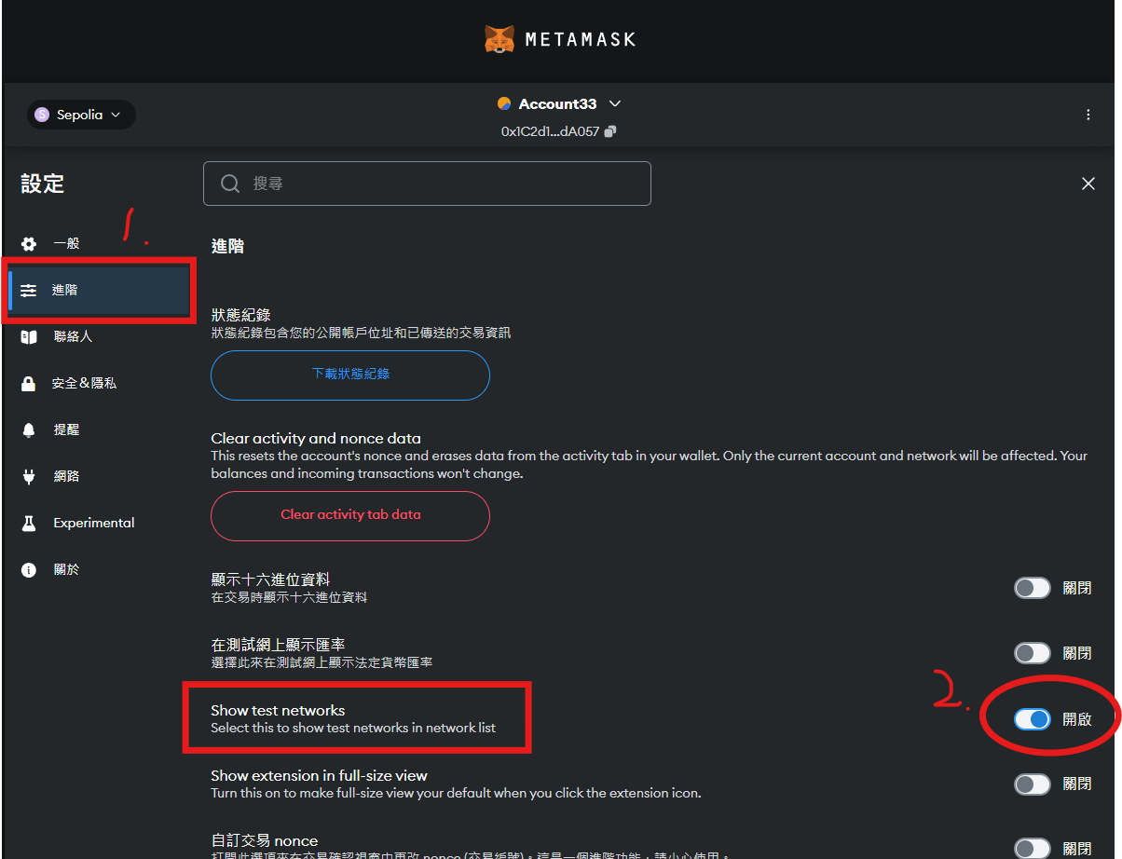
MetaMask (狐狸錢包) (3/3)

Slide 8
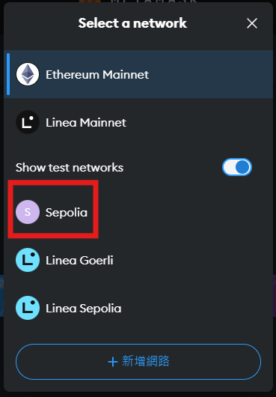
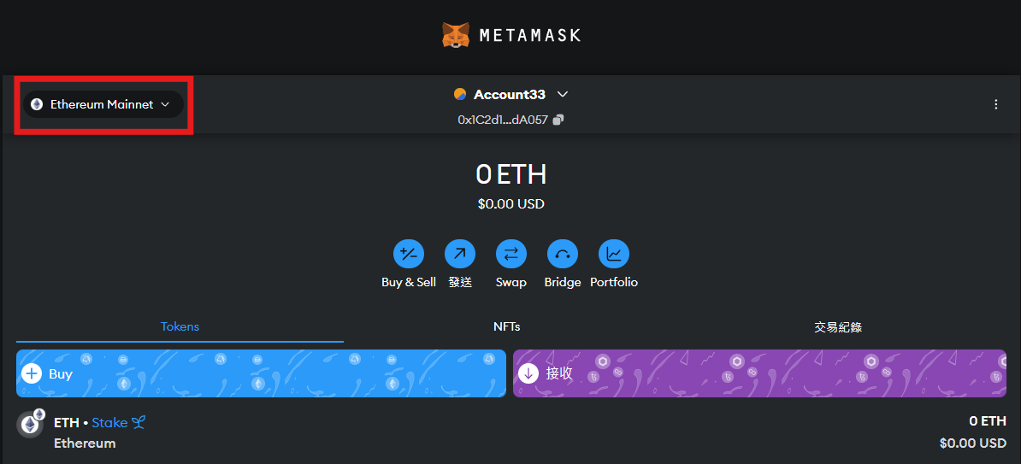

Slide 9
SepoliaETH
乙太坊基金會維護的官方測試鏈
將撰寫好的智能合約佈署在測試鏈測試功能，避免直接發行到主鏈上後即產生實際花銷。
Etherscan : https://sepolia.etherscan.io/

Slide 10
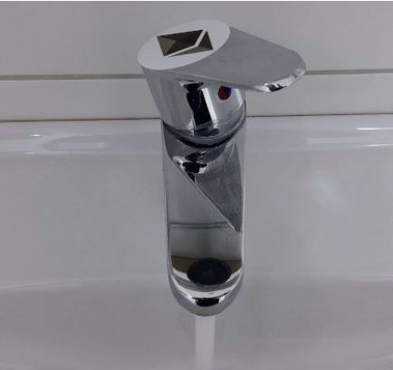
Faucet
如何取得測試幣?
  https://faucets.chain.link/
  https://sepolia-faucet.pk910.de/#/
用途：官方或第三方提供給一般
使用者免費(或有償)領取測試幣的管道。

Slide 11
Remix IDE
https://remix.ethereum.org/
提供了一個線上的開發環境，支援Solidity語言，這是以太坊區塊鏈上智能合約的主要語言。
可以連結metamask等應用程式，與特定公共鏈上的電子錢包互動。
內建完整的編譯與測試工具，能夠快速測試智能合約的運作與功能。

Slide 12
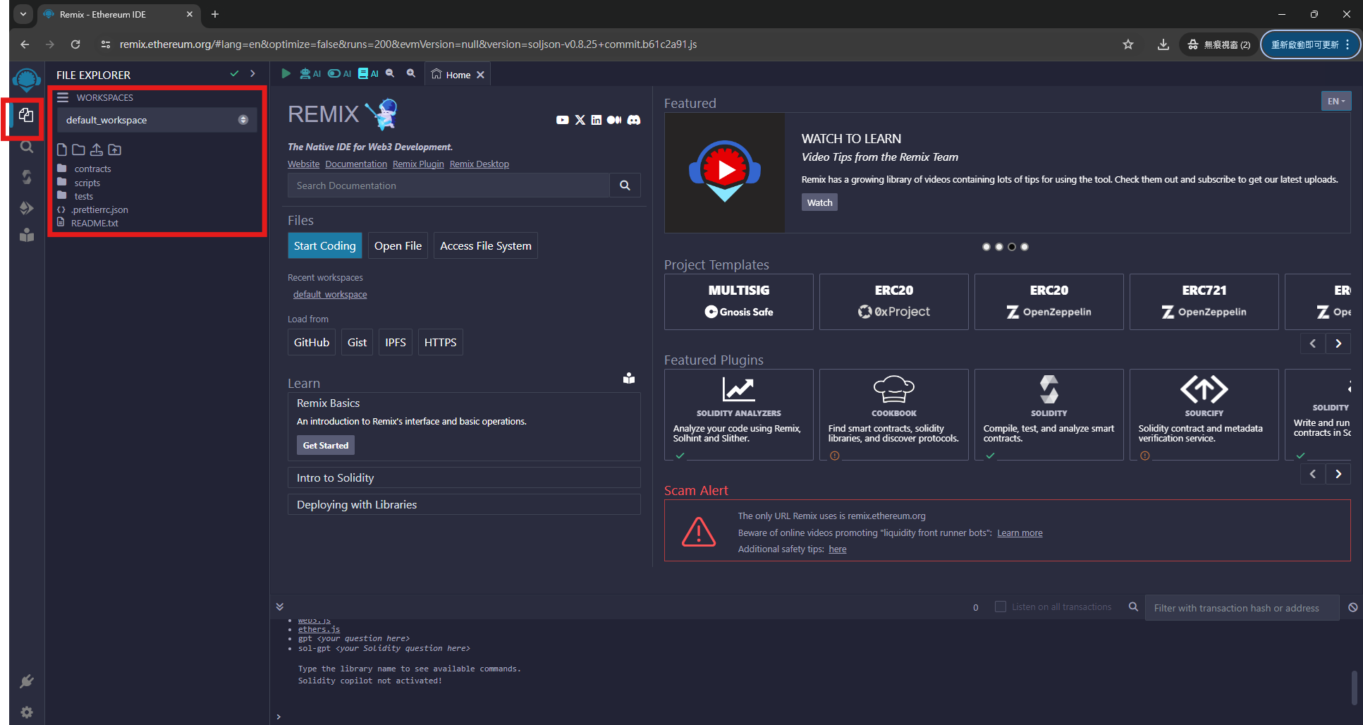

Slide 13
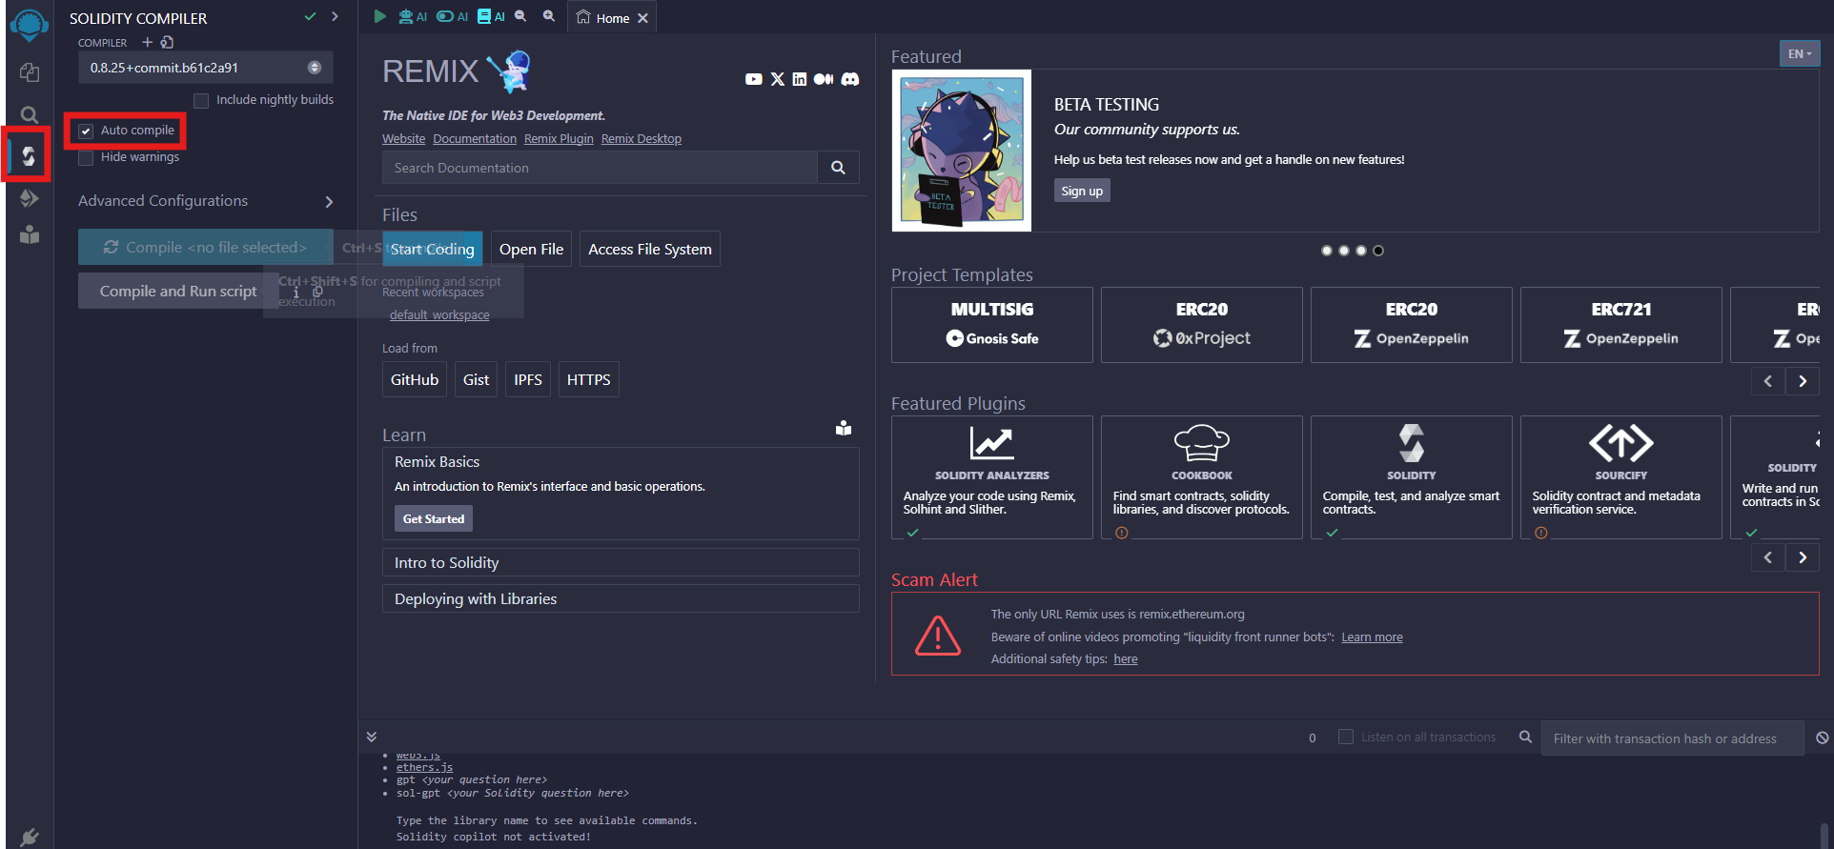

Slide 14
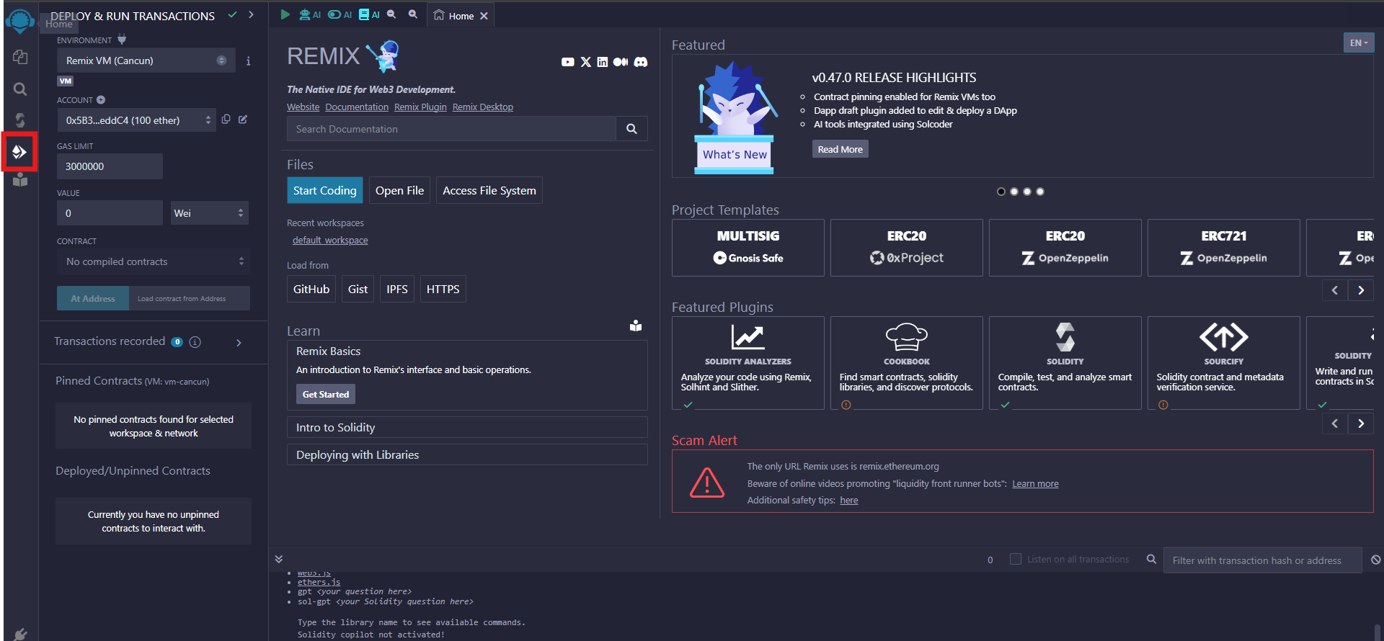

Slide 15
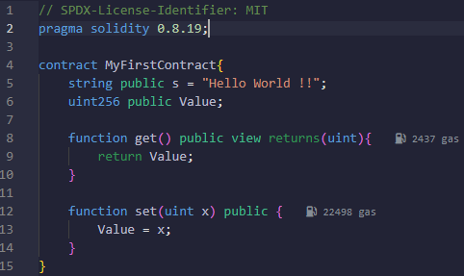
Solidity tutorial (1/4)
Make sure that remix has already connected to Metmask while writing your homework.
Deploy the smart contract.

Slide 16
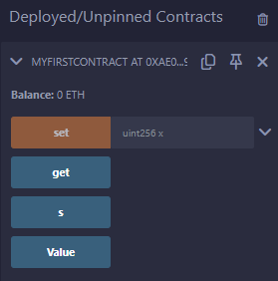
Solidity tutorial (2/4)
Open the deployed Contracts.
Try to press get button.
Try to press set button with any positive value as the input of the funcion.
Try to press get button again.

Slide 17
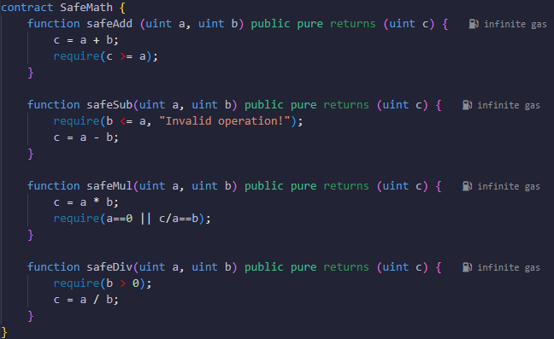
Solidity tutorial (3/4)
require(condition, message)：
While the condition was “false”, the execution of the function would terminate, and print the message.

Slide 18
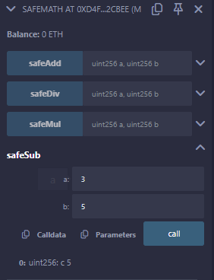
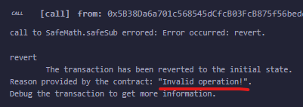
Solidity tutorial (4/4)

Slide 19
hw2_Q1
Create your own token and transfer 100 tokens to TA (0xF327C323A6E6eAf85063f4E60a366Cd21EFB89A5).
We use ERC-20 protocol to issue our own tokens.
See the sample code in sample.sol
2 Screenshots are necessary before and after you successfully transfer 100 tokens to TA.

Slide 20
ERC-20
1. 乙太坊上目前最多人使用的標準。
2. 可在乙太坊區塊鏈上，透過此標準發行自己的虛擬貨幣，除了提高代幣的互換性外，更是Dapp中必不可少的組件。
3. ERC-20包含六個功能函式、兩個事件，以及三個紀錄自定義Token相關資訊的函式。

Slide 21
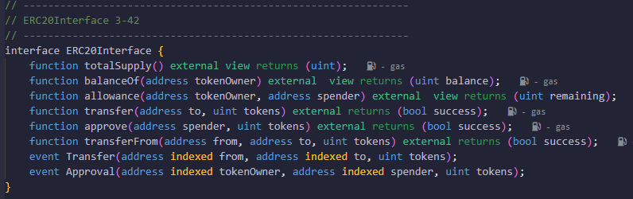
ERC-20

Slide 22
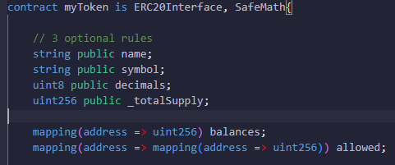
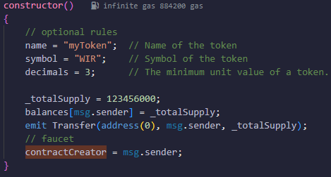
ERC-20

Slide 23
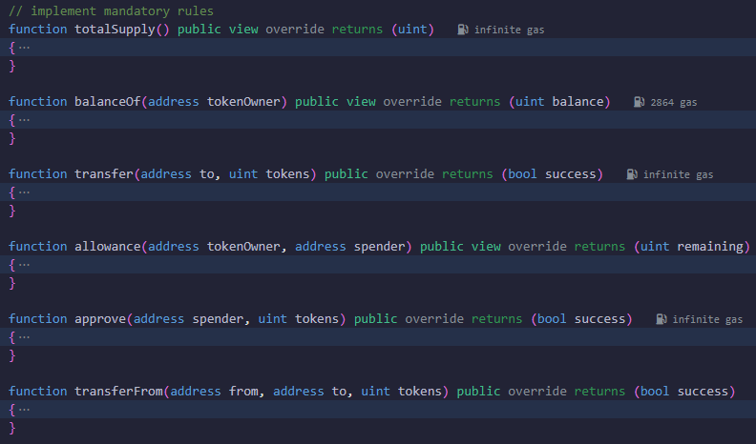
ERC-20

Slide 24
hw2_Q2 (1/2)
Write a function similar to the faucet, and you can add some variables for it.
  The person (address) who established the contract acts as a faucet and is responsible for distributing tokens to other requesters, but can no longer take tokens from himself/herself.
  Others (other addresses) can call the function to claim 500 tokens at a time, and the same address can only claim once within 30 seconds.
  Hint: You should create a function named “faucet”. Then, use the concepts of “require” and “block.timestamp” to implement it.

Slide 25
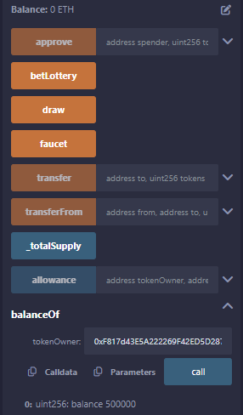
hw2_Q2 (2/2)
A screenshot is needed after the user using “faucet”
function, and call “balanceOf” function.

Slide 26
hw2_Q3
Write a lottery game.
  The person (address) who established the contract acts as a seller and is responsible for selling lottery ticket to other customers, but can no longer buy lottery ticket by himself/herself.
  Customers (other addresses) can give 100 tokens to the seller to buy a lottery ticket at a time, and he/she can buy multiple times.
  Seller draw the winner and give him/her 90% of total lottery tokens.

